Slide 1

Connecting to the Database, Normalization Forms

Slide 2
Agenda
Table
Views

Slide 3
Tables
Tables are database objects that contain all the data in a database.
In tables, data is logically organized in a row-and-column format similar to a spreadsheet.
Each row represents a unique record, and each column represents a field in the record.

Slide 4
Types of Tables
Partitioned Tables
Temporary Tables
System Tables
Wide Tables

Slide 5
Partitioned Tables
Partitioned tables are tables whose data is horizontally divided into units which may be spread across more than one filegroup in a database.
Partitioning makes large tables or indexes more manageable by letting you access or manage subsets of data quickly and efficiently, while maintaining the integrity of the overall collection.
By default, SQL Server supports up to 15,000 partitions.

Slide 6
Temporary Tables
Temporary tables are stored in tempdb. There are two types of temporary tables: local and global. They differ from each other in their names, their visibility, and their availability.
Local temporary tables have a single number sign (#) as the first character of their names; they are visible only to the current connection for the user, and they are deleted when the user disconnects from the instance of SQL Server.
Global temporary tables have two number signs (##) as the first characters of their names; they are visible to any user after they are created, and they are deleted when all users referencing the table disconnect from the instance of SQL Server.

Slide 7
System Tables
SQL Server stores the data that defines the configuration of the server and all its tables in a
special set of tables known as system tables. Users cannot directly query or update the system tables.
The information in the system tables is made available through the system views

Slide 8
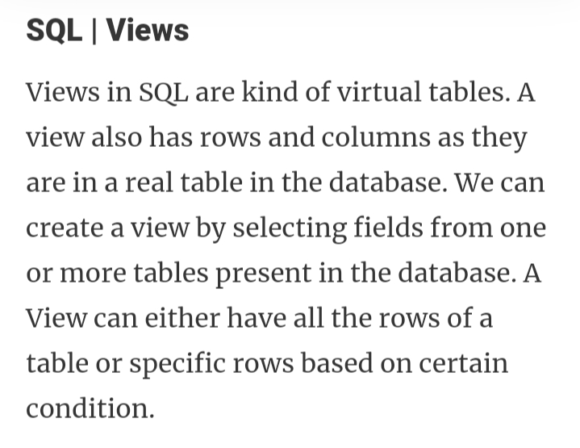

Slide 9
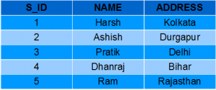

Slide 10
Normalization
Normalization is a database design technique that reduces data redundancy and eliminates undesirable characteristics like Insertion, Update and Deletion Anomalies.
Normalization rules divides larger tables into smaller tables and links them using relationships.
The purpose of Normalization in SQL is to eliminate redundant (repetitive) data and ensure data is stored logically

Slide 11
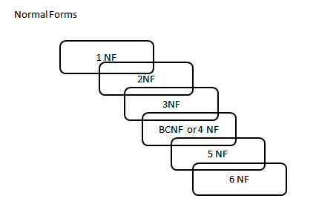
Database Normal Forms

Slide 12
1NF (First Normal Form)
2NF (Second Normal Form)
3NF (Third Normal Form)
BCNF (Boyce-Codd Normal Form)
4NF (Fourth Normal Form)
5NF (Fifth Normal Form)
6NF (Sixth Normal Form)

Slide 13
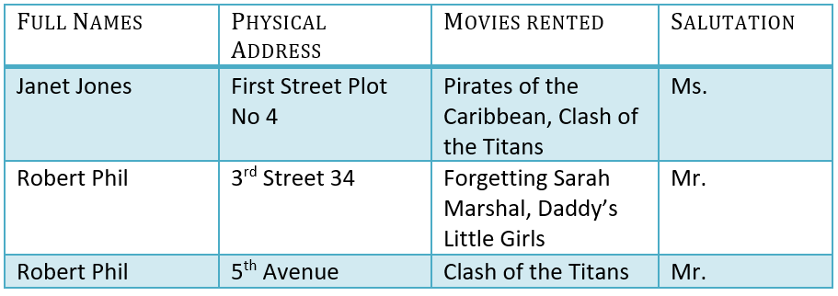
Assume, a video library maintains a database of movies rented out.
Without any normalization in database, all information is stored in one table as shown below.

Slide 14
1NF (First Normal Form)
RULES
Each table cell should contain a single value.
Each record needs to be unique

Slide 15
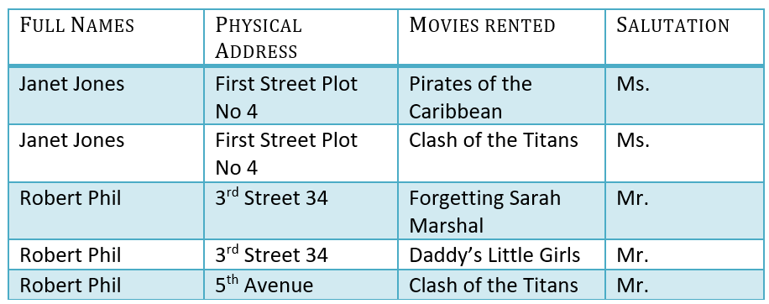
1NF Example

Slide 16
KEY
A KEY is a value used to identify a record in a table uniquely.
A KEY could be a single column or combination of multiple columns
Note: Columns in a table that are NOT used to identify a record uniquely are called non-key columns.

Slide 17
Primary Key
A primary is a single column value used to identify a database record uniquely.
It has following attributes
A primary key cannot be NULL
A primary key value must be unique
The primary key values should rarely be changed
The primary key must be given a value when a new record is inserted.

Slide 18
Composite Key
A composite key is a primary key composed of multiple columns used to identify a record uniquely
In our database, we have two people with the same name Robert Phil, but they live in different places.
Hence, we require both Full Name and Address to identify a record uniquely. That is a composite key.

Slide 19
2NF (Second Normal Form)
Rule 1- Be in 1NF
Rule 2- Single Column Primary Key
It is clear that we can't move forward to make our simple database in 2nd Normalization form unless we partition the table above.

Slide 20

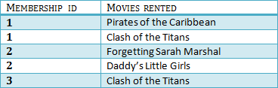
Table1
Table2

Slide 21
We have divided our 1NF table into two tables viz. Table 1 and Table2.
Table 1 contains member information. Table 2 contains information on movies rented.
We have introduced a new column called Membership_id which is the primary key for table 1.
Records can be uniquely identified in Table 1 using membership id

Slide 22
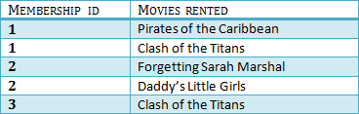
Foreign Key
In Table 2, Membership_ID is the Foreign Key

Slide 23
Foreign Key references the primary key of another Table! It helps connect your Tables
A foreign key can have a different name from its primary key
It ensures rows in one table have corresponding rows in another
Unlike the Primary key, they do not have to be unique. Most often they aren't
Foreign keys can be null even though primary keys can not

Slide 24
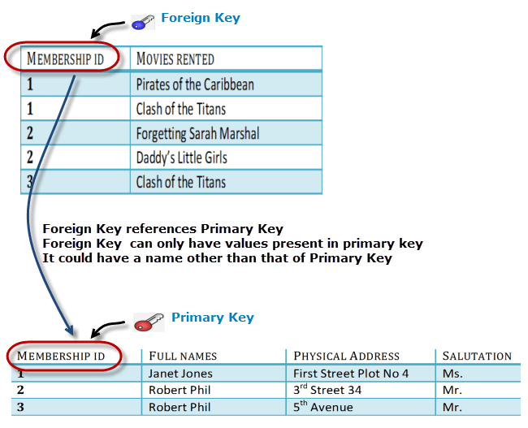

Slide 25
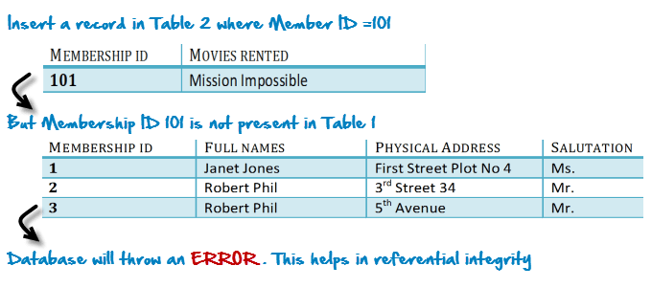
Why do you need a foreign key?
Suppose, a novice inserts a record in Table B such as

Slide 26
You will only be able to insert values into your foreign key that exist in the unique key in the parent table. This helps in referential integrity.
The above problem can be overcome by declaring membership id from Table2 as foreign key of membership id from Table1
Now, if somebody tries to insert a value in the membership id field that does not exist in the parent table, an error will be shown!

Slide 27
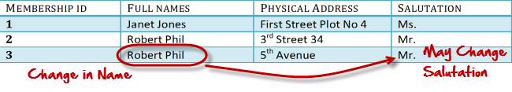
What are transitive functional dependencies?
A transitive functional dependency is when changing a non-key column, might cause any of the other non-key columns to change
Consider the table 1. Changing the non-key column Full Name may change Salutation.

Slide 28
3NF (Third Normal Form) Rules
Rule 1- Be in 2NF
Rule 2- Has no transitive functional dependencies
To move our 2NF table into 3NF, we again need to again divide our table.

Slide 29

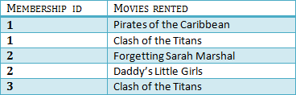


Slide 30
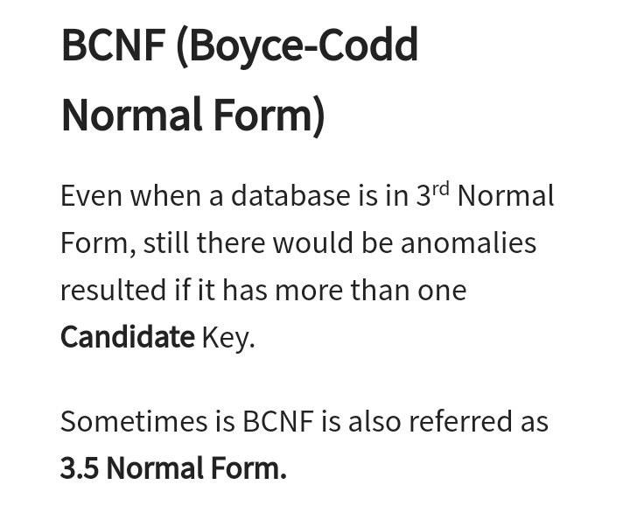

Slide 31
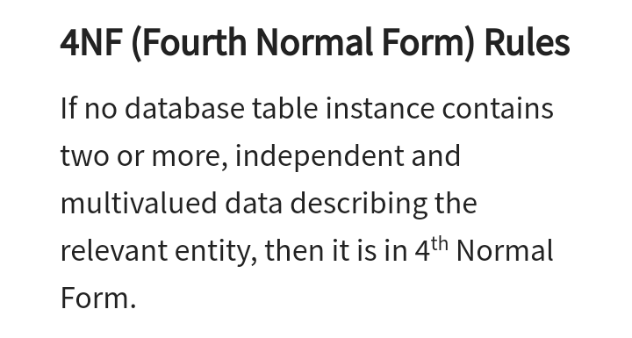

Slide 32
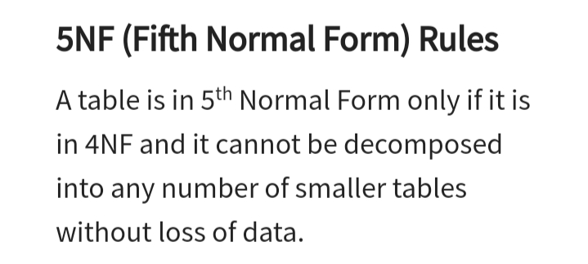

Slide 33
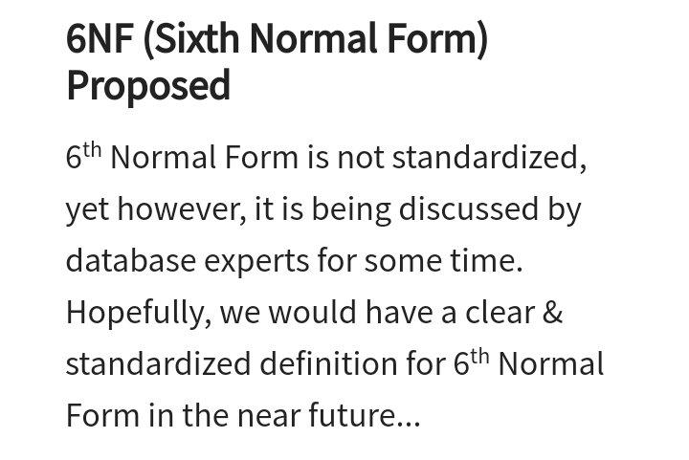

Slide 34
Java Database Connectivity with 5 Steps
There are 5 steps to connect any java application with the database using JDBC. These steps are as follows:
Register the Driver class
Create connection
Create statement
Execute queries
Close connection

Slide 35
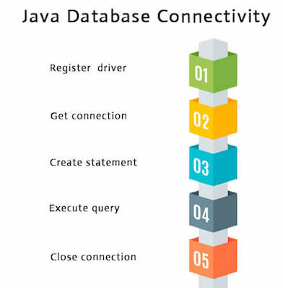

Slide 36
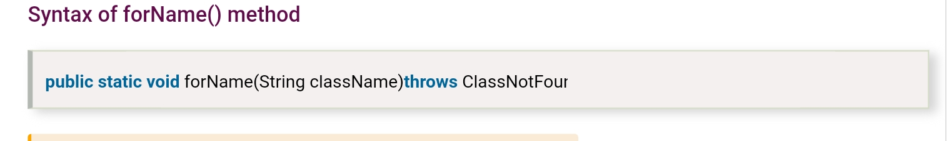
Register the driver class
The forName() method of Class class is used to register the driver class. This method is used to dynamically load the driver class.
Class.forName("oracle.jdbc.driver.OracleDriver")

Slide 37
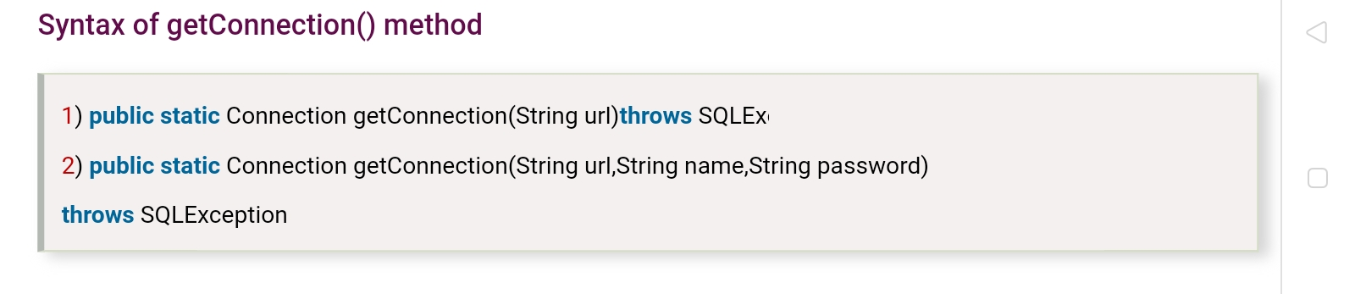
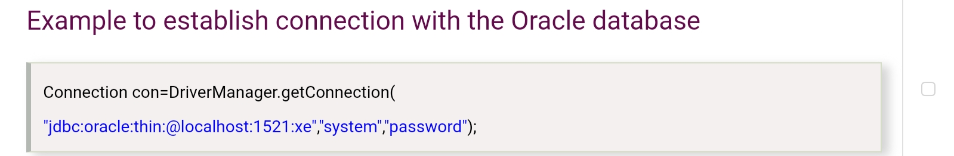
Create the connection object
The getConnection() method of DriverManager class is used to establish connection with the database.

Slide 38

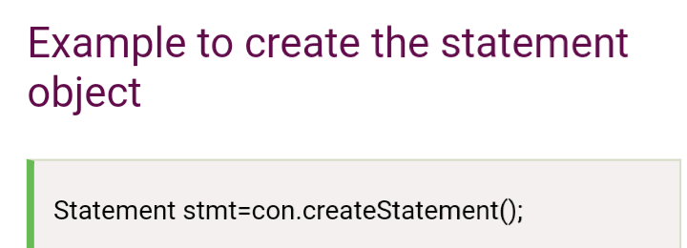
Create the Statement object
The createStatement() method of Connection interface is used to create statement.
The object of statement is responsible to execute queries with the database.
Syntax of createStatement() method

Slide 39
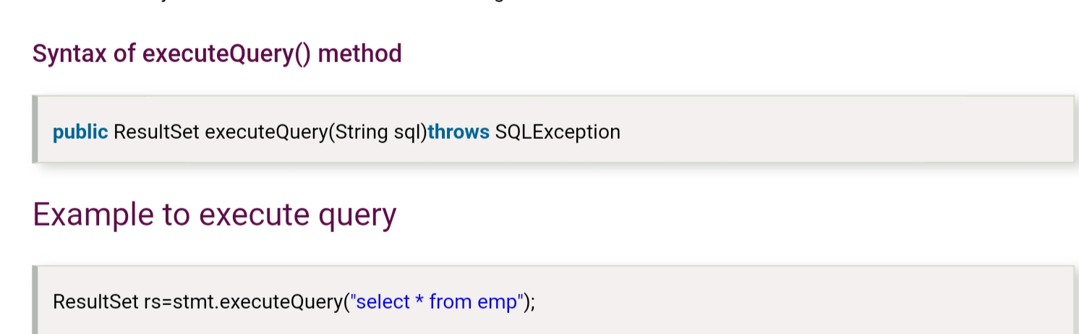
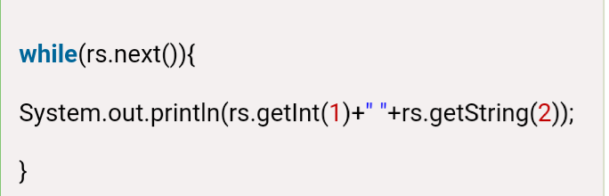
Execute the query
The executeQuery() method of Statement interface is used to execute queries to the database. This method returns the object of ResultSet that can be used to get all the records of a table.

Slide 40
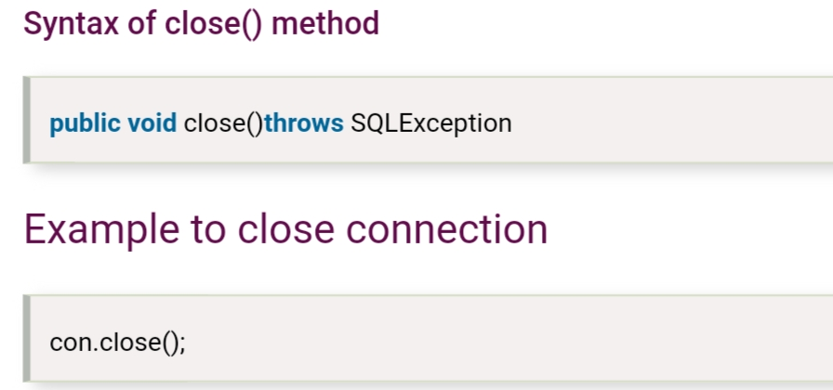
Close the connection object
By closing connection object statement and ResultSet will be closed automatically. The close() method of Connection interface is used to close the connection.

Slide 41


